Slide 1

CASE STUDY EXPLORATORY
DATA ANALYSIS​
TMDB MOVIE DATA :
​
MENTORED BY – JAYA PANDEY​
PRESENTED BY- PUSHKAR HEDAU​
​

Slide 2
Introduction---
A Production company wants to analyze the movie data to identify which movies perform well in cinemas and which genre it belongs and what is its budget and revenue . How much popularity the movies has and which production companies are associated with them and several other parameters are used to analyze the data , to know which movie is going to be a commercial success.
The TMDB dataset contains 4803 rows and 20 columns, namely budget, genres, id, language, title, popularity, revenue, runtime, status, vote count and vote average , to name a few.
Objective--
To find those parameters that make a movie a commercial success

Slide 3
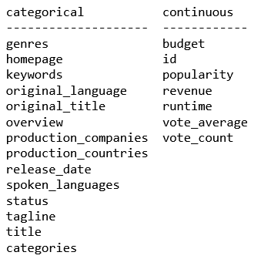
Level Zero : Understanding Data
Inspect
Visually inspect the first few and last few rows of the data.
Check
Check the shape of the data frame.
Check
Check the count of null values in each column.
Inspect
Inspect all the column names and cross check with the data dictionary.
Check
Check the information of the data frame using the info() function.

Slide 4
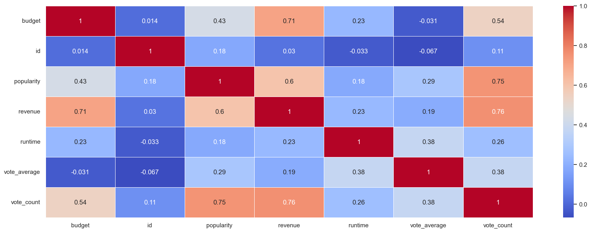
Heat map to find correlation between variables
There is good correlation between budget and revenue.
Popularity has good correlation with revenue and vote count.
Runtime does not have any good correlation with any variable. But it is negatively correlated , so with increase in runtime we may not get increase in budget or revenue or popularity.

Slide 5
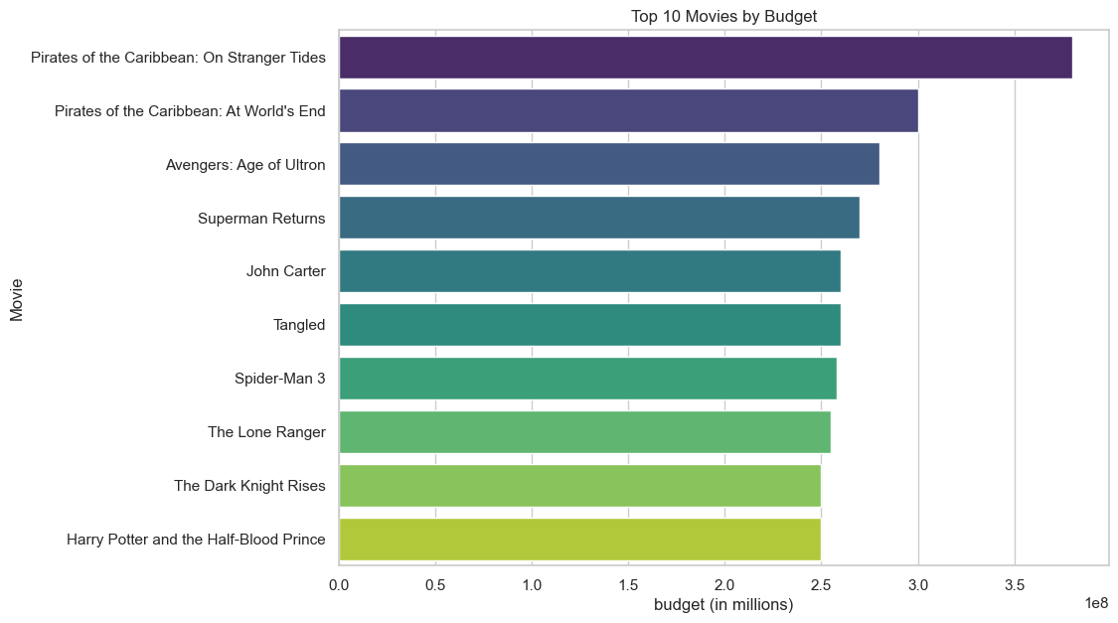
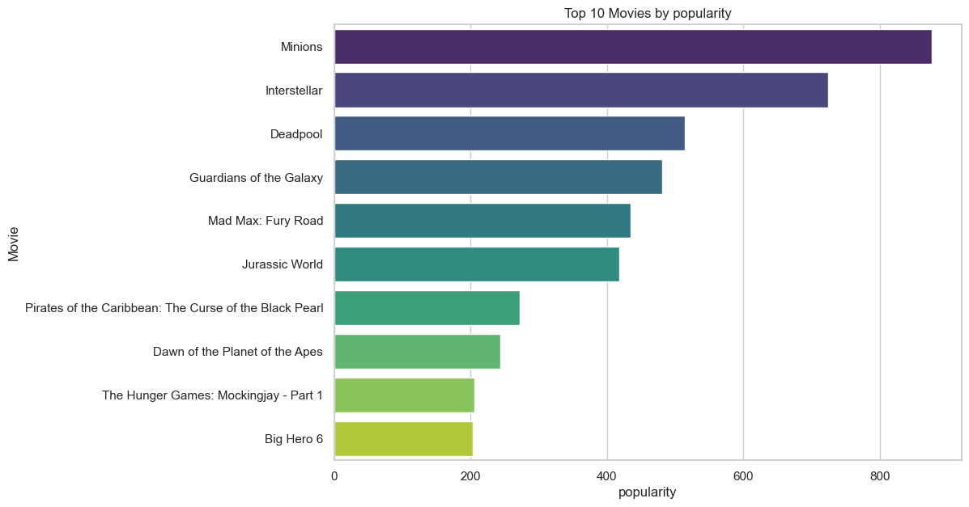
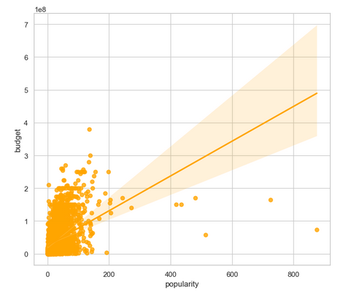
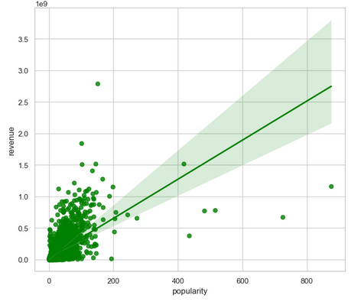
Interpretation --
On the basis of budget movie pirates of Caribbean has the largest budget but it is not that much popular among people.
On the basis of popularity the minions movie is the highest but its budget is not very much .
For determining whether a movie will be a commercial success only budget and popularity is not sufficient

Slide 6
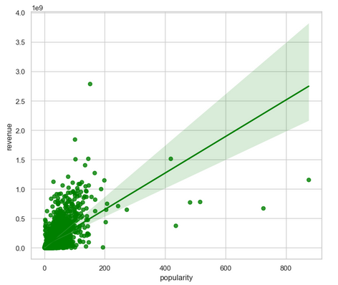
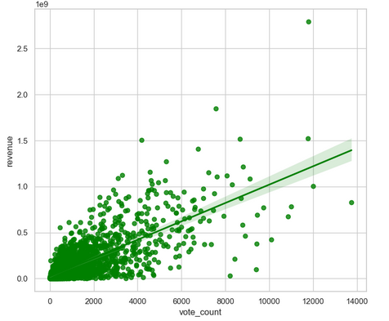
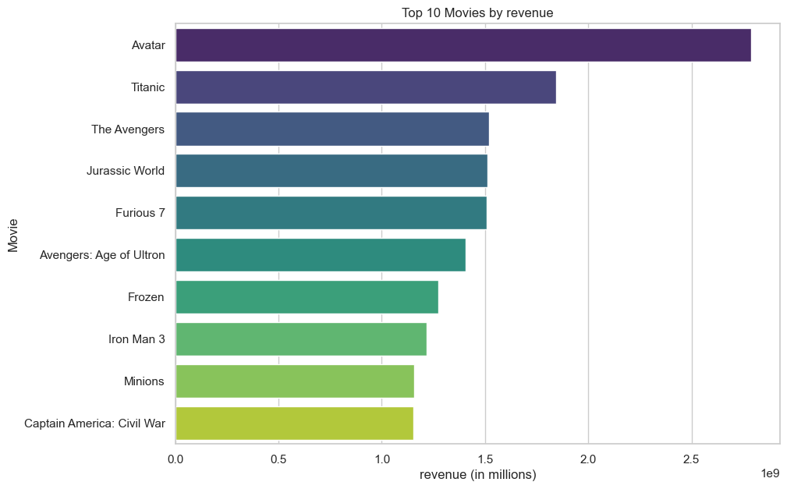
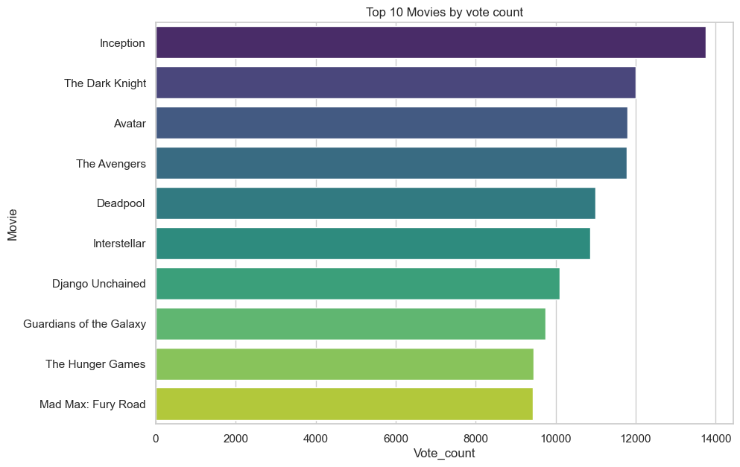
Interpretation--
On the basis of only vote count the top performing movie is inception i.e. this movie has got the maximum votes.
On the basis of revenue generation movie avatar and titanic are the top performers.
On the basis of the correlation between revenue and vote count , we are getting similar number of movies that are performing and not doing so well.
Only vote count cannot tell whether a movie will be a commercial success or not.

Slide 7
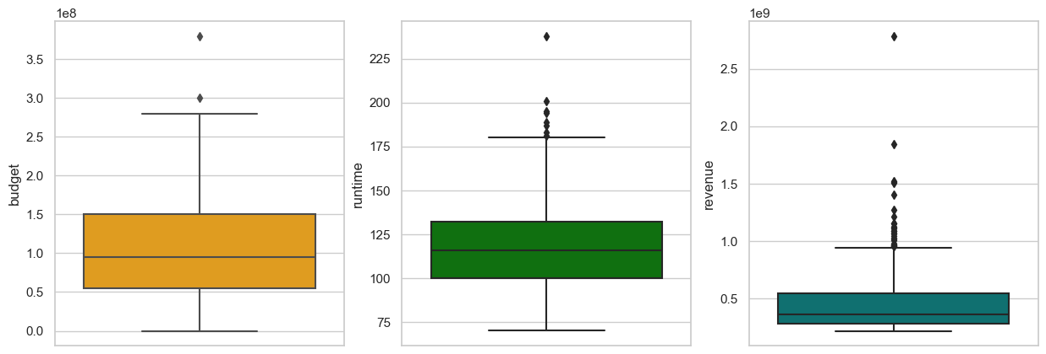
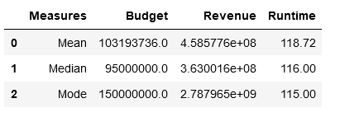
Interpretation ---
On the basis of measures of central tendency ie. Mean, median , and mode for budget , runtime, revenue.
Mean is greater than the median for all the three parameters , which shows the data is positively skewed.
On the boxpot for budget and runtime there are very less number of outliers.
For revenue the data is more concertrated till $500 billion and some outliers are also present in the data .
Due to the presence of outliers the mean is drawn towards the higher values and cause skewness in the data.

Slide 8
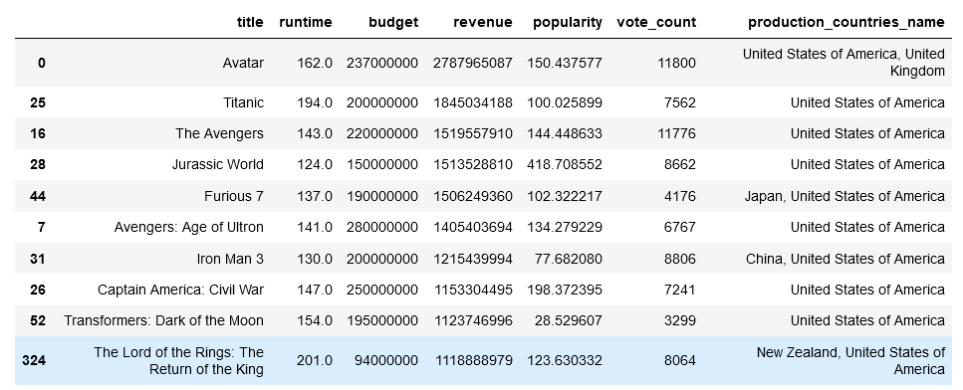
For a movie to be a commercial success a variety of parameters play their role. To get that, we have taken all those movies that have a runtime greater than the average runtime and taken out the top 10 best performing movies on the basis of revenue generated. And compared then to top 10 movies on the basis of revenue only .
There is some change in the top performing movies otherwise the top 5 best movies are same.

Slide 9
Conclusion --
On the basis of revenue only we can determine whether a movie is a commercial success or not, but yes budget, popularity, vote count all contribute towards a commercial success.
In terms of correlation between budget and revenue i.e 0.71 , for a movie to be a commercial success , contribution of budget is only 7/10 i.e 7 out of 10 movies with high budget can be a commercial success.
In terms of popularity , 6 out of 10 movies that have high popularity can become a commercial success, since the correlation between popularity and revenue is 0.61
In terms of vote count , 8 out of 10 movies that have a high votecount can be a commecial success.

